Slide 1
Bio& 241 A&P 1
Unit 3 / Lecture 1

Slide 2
Introduction to Muscles
Origin: Attachment of a muscle tendon to the stationary bone.
Insertion: Attachment of the other muscle tendon to the movable bone.
Action: The movement that occurs at the joint due to muscle contraction.

Slide 3
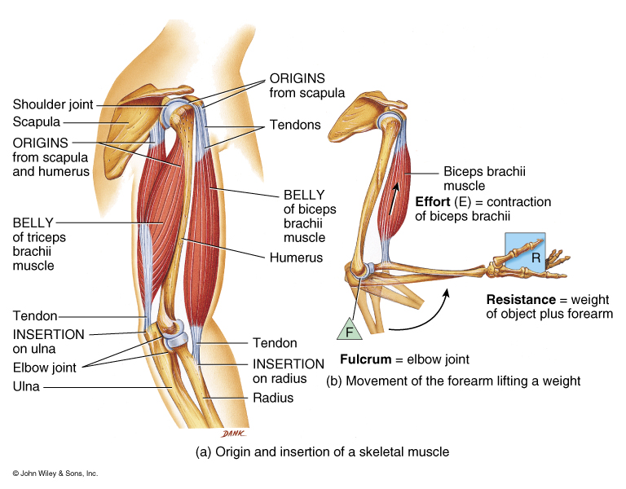
Origin and Insertion

Slide 4
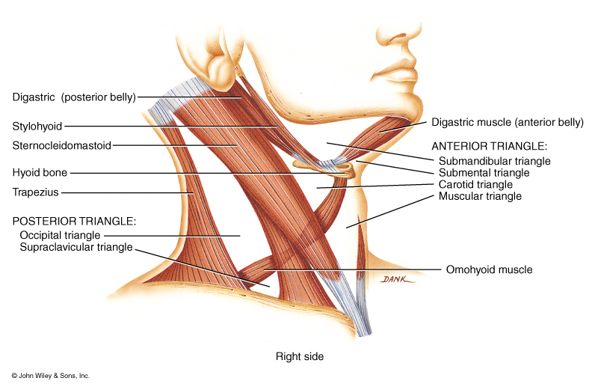
Belly

Slide 5
Characteristics Used to Name Muscles
Direction of Fibers
Size of Muscle
Shape of Muscle
Action of Muscles
Number of Origins of Muscle
Location of Muscle
Origin and Insertion of Muscle

Slide 6
Characteristics Used to Name Muscles
Direction of Muscle Fibers
  Rectus: Parallel to midline
  Transverse: Perpendicular to midline
  Oblique: Diagonal to midline

Slide 7
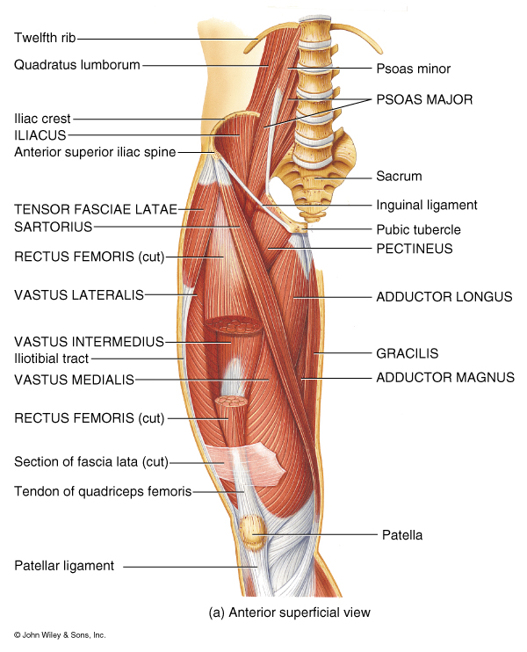
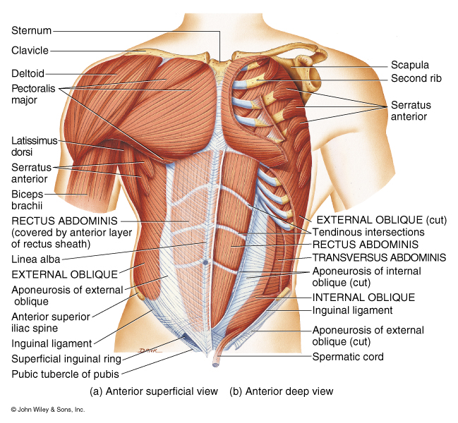
Rectus: Parallel to midline

Slide 8
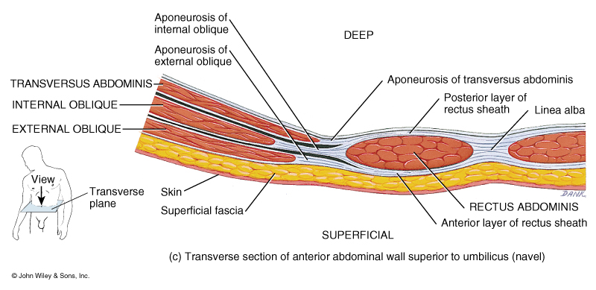
Transverse: Perpendicular to midline

Slide 9
Oblique: Diagonal to midline

Slide 10
Characteristics Used to Name Muscles
Size of the Muscle:
  Maximus: Largest muscle in a group
  Minimus: Smallest muscle in a group
  Longus: Longest muscle in a group
  Brevis: Shortest muscle in a group
  Latissimus: Widest muscle in a group
  Magnus: Largest muscle in a group
  Major: Largest muscle in a group
  Minor: Smallest muscle in a group
  Vastus: Great or large muscle

Slide 11
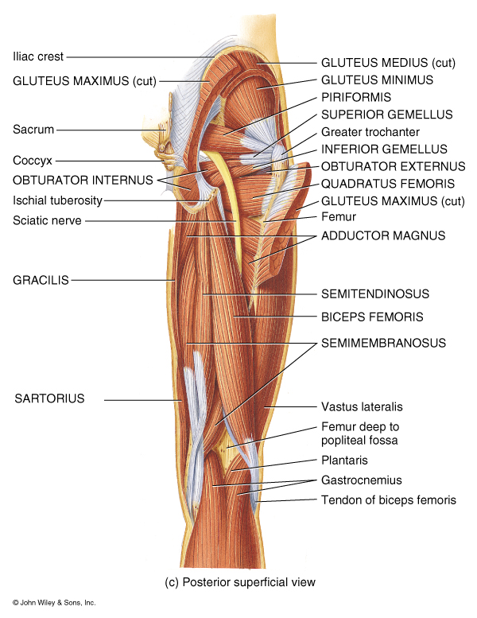
Maximus: Largest muscle in a group

Slide 12
Minimus: Smallest muscle in a group

Slide 13
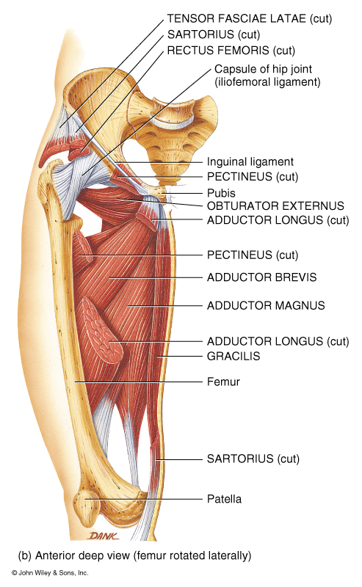
Longus: Longest muscle in a group

Slide 14
Brevis: Shortest muscle in a group

Slide 15
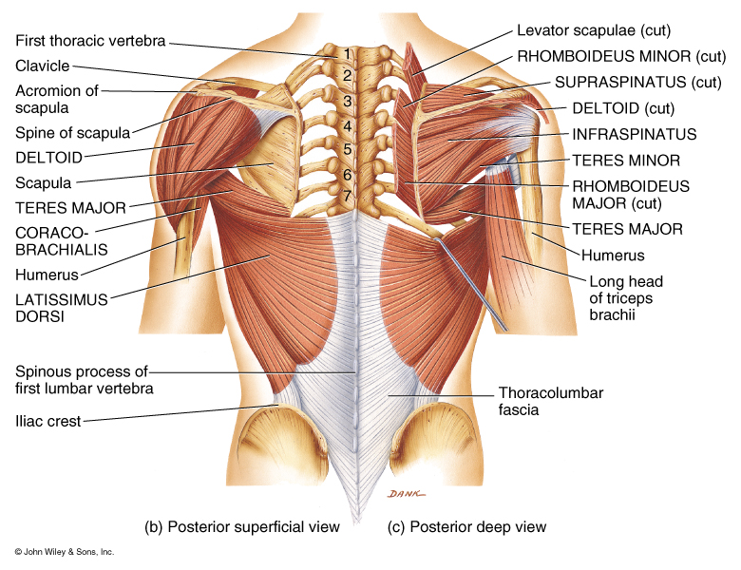
Latissimus: Widest muscle in a group

Slide 16
Major: Largest muscle in a group

Slide 17
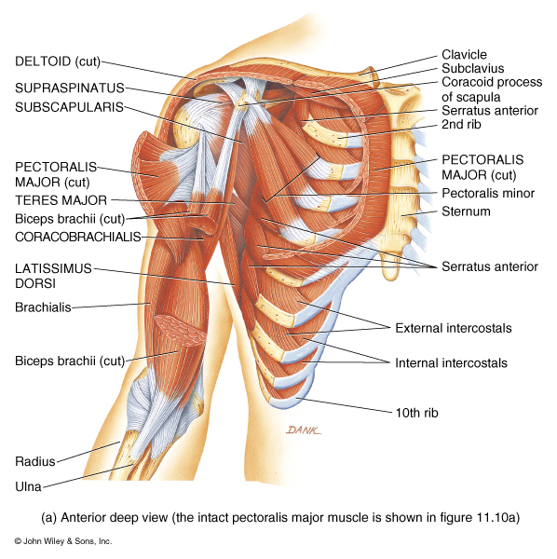
Minor: Smallest muscle in a group

Slide 18
Vastus: Great or large muscle

Slide 19
Characteristics Used to Name Muscles
Shape of Muscle
  Deltoid: Triangular shaped
  Trapezius: Trapezoid shaped
  Serratus: Saw-toothed muscle edge
  Rhomboideus: Diamond shaped
  Orbicularis: Circular shaped
  Pectinate: Comblike shaped
  Platys: Flat muscle
  Quadratus: Square shaped
  Gracilis: slender muscle

Slide 20
Deltoid: Triangular shaped

Slide 21
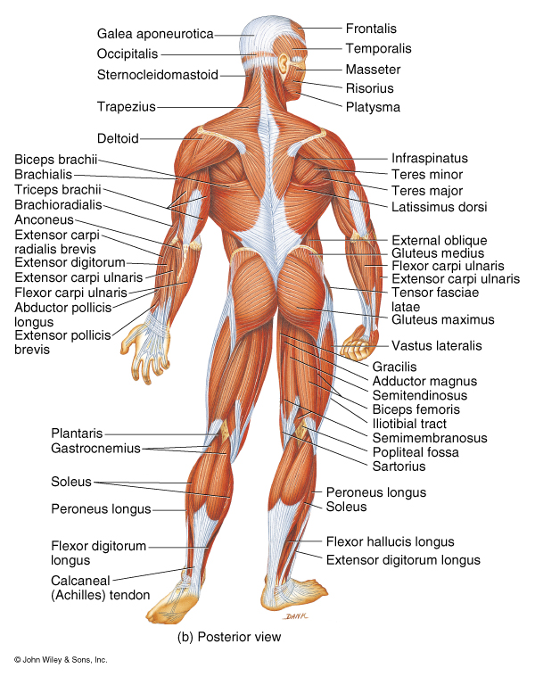
Trapezius: Trapezoid shaped

Slide 22
Serratus: Saw-toothed muscle edge

Slide 23
Rhomboideus: Diamond shaped

Slide 24
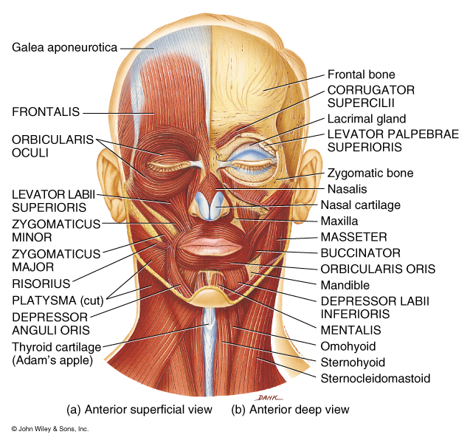
Orbicularis: Circular shaped

Slide 25
Pectinate: Comblike shaped

Slide 26
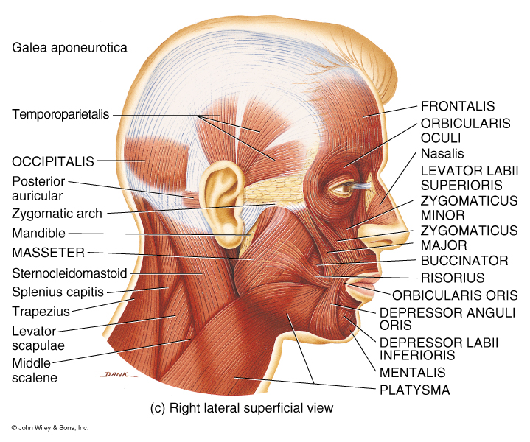
Platys: Flat muscle

Slide 27
Quadratus: Square shaped

Slide 28
Gracilis: Slender muscle

Slide 29
Characteristics Used to Name Muscles
Action of Muscles
  Flexor: Decreases angle at joint
  Extensor: Increases angle at joint
  Abductor: Moves bone away from midline
  Adductor: Moves bone toward midline
  Levator: Produces superior movement
  Depressor: Produces inferior movement
  Supinator: Turns palm anteriorly
  Pronator: Turns palm posteriorly
  Sphincter: Decreases size of opening
  Tensor: Makes a body part rigid
  Rotator: Moves bone around an axis

Slide 30
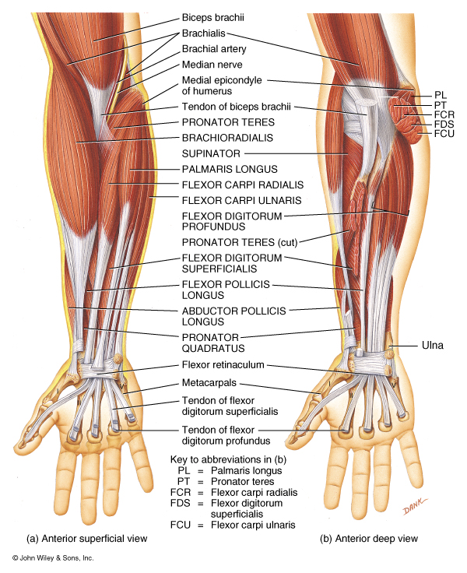
Flexor: Decreases angle at joint

Slide 31
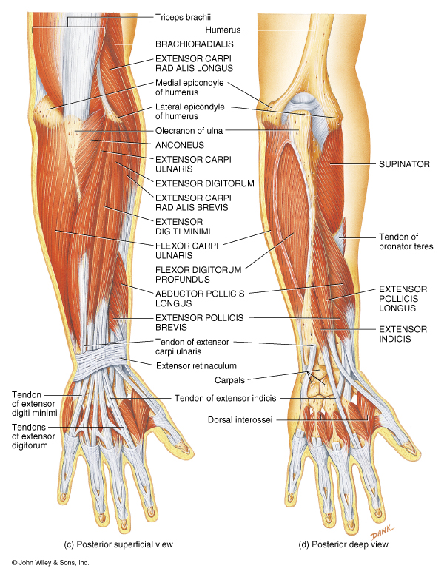
Extensor: Increases angle at joint

Slide 32
Adductor: Moves bone toward midline

Slide 33
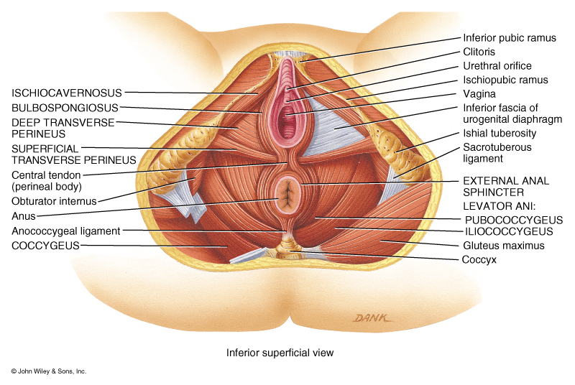
Levator: Produces superior movement

Slide 34
Depressor: Produces inferior movement

Slide 35
Supinator: Turns palm anteriorly

Slide 36
Pronator: Turns palm posteriorly

Slide 37
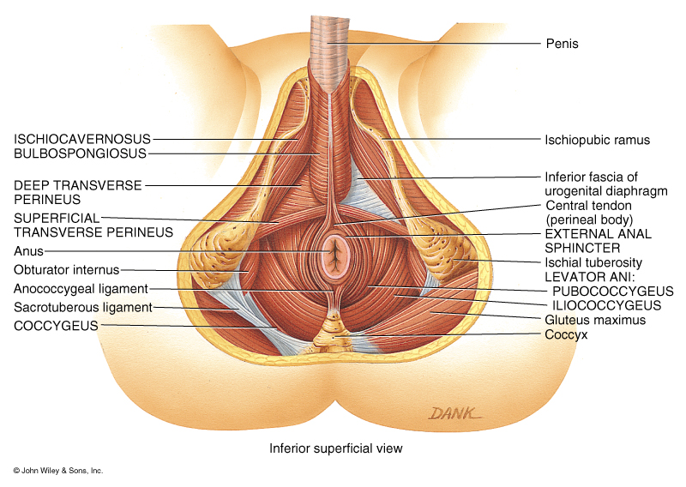
Sphincter: Decreases size of opening

Slide 38
Tensor: Makes a body part rigid

Slide 39
Characteristics Used to Name Muscles
Number of Origins of Muscle
  Biceps: Muscle with two origins
  Triceps: Muscle with three origins
  Quadriceps: Muscle with four origins

Slide 40
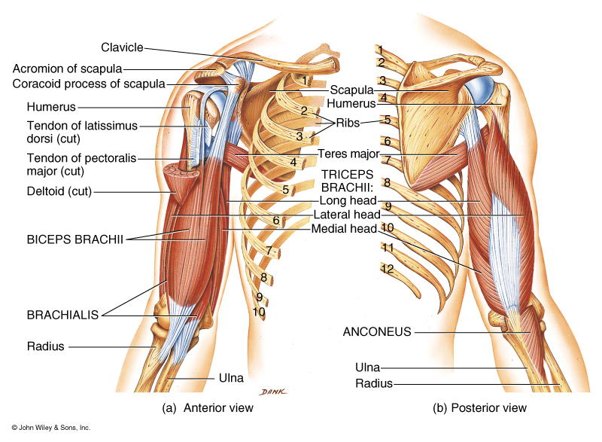
Biceps: Muscle with two origins

Slide 41
Triceps: Muscle with three origins

Slide 42
Quadriceps: Muscle with four origins

Slide 43
Location of Muscle

Slide 44
Origin and Insertion of Muscle

Slide 45
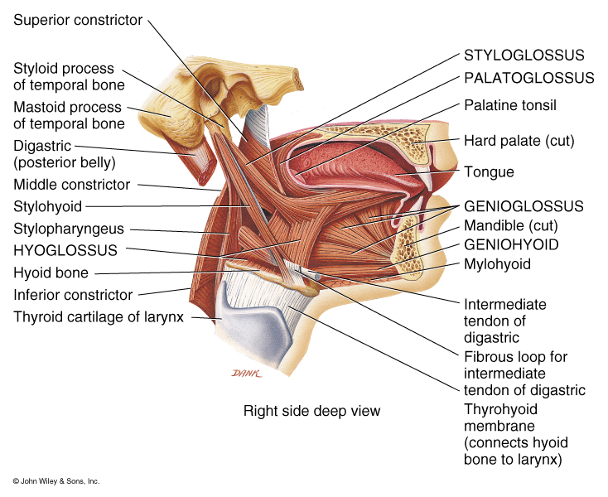
Origin and Insertion of Muscle

Slide 46
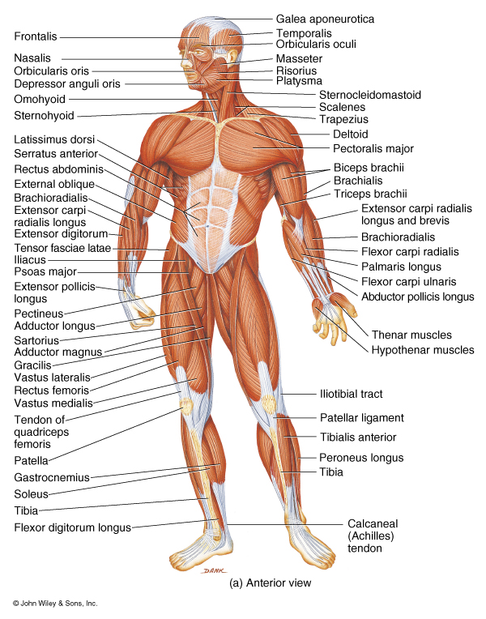

Slide 50
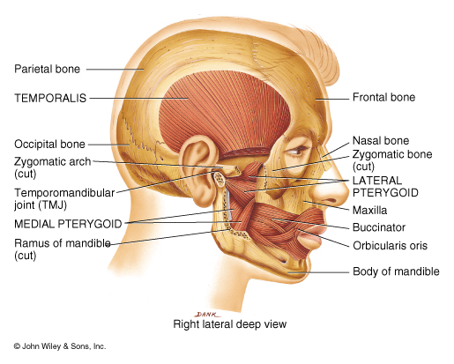

Slide 52
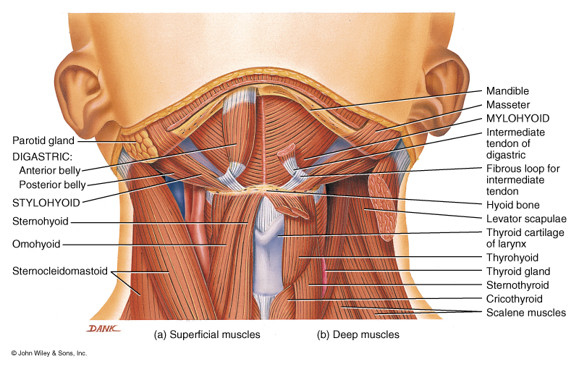

Slide 53
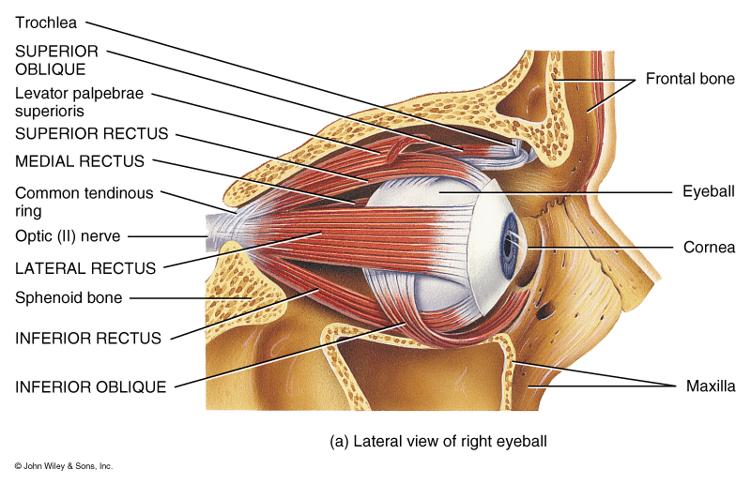
Extrinsic Muscles of the Eye

Slide 54
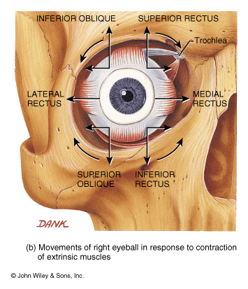
Extrinsic Muscles of the Eye

